Slide 1
Decipher the functional consequenes of a twist KO in Nematostella vectensis

Slide 2
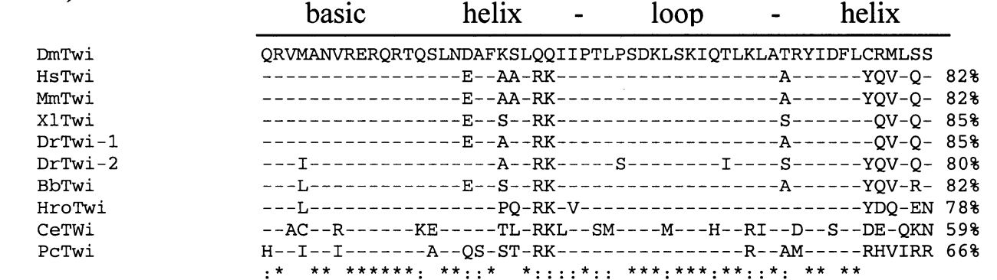
Twist protein is involved in a variety of cellular processes
Twist protein acts as a master transcription factor (highly conserved)
basic helix-loop-helix structure;
bind to E-box (5’-CATATG-3’) motif
found in metazoa
Drosophila (mesoderm formation)
Human cancer (EMT)
Source: Expasy: SIB (Twist, Nematostella vectensis);
Irinka Castanon & Mary K. Baylies, Genes 2002

Slide 3
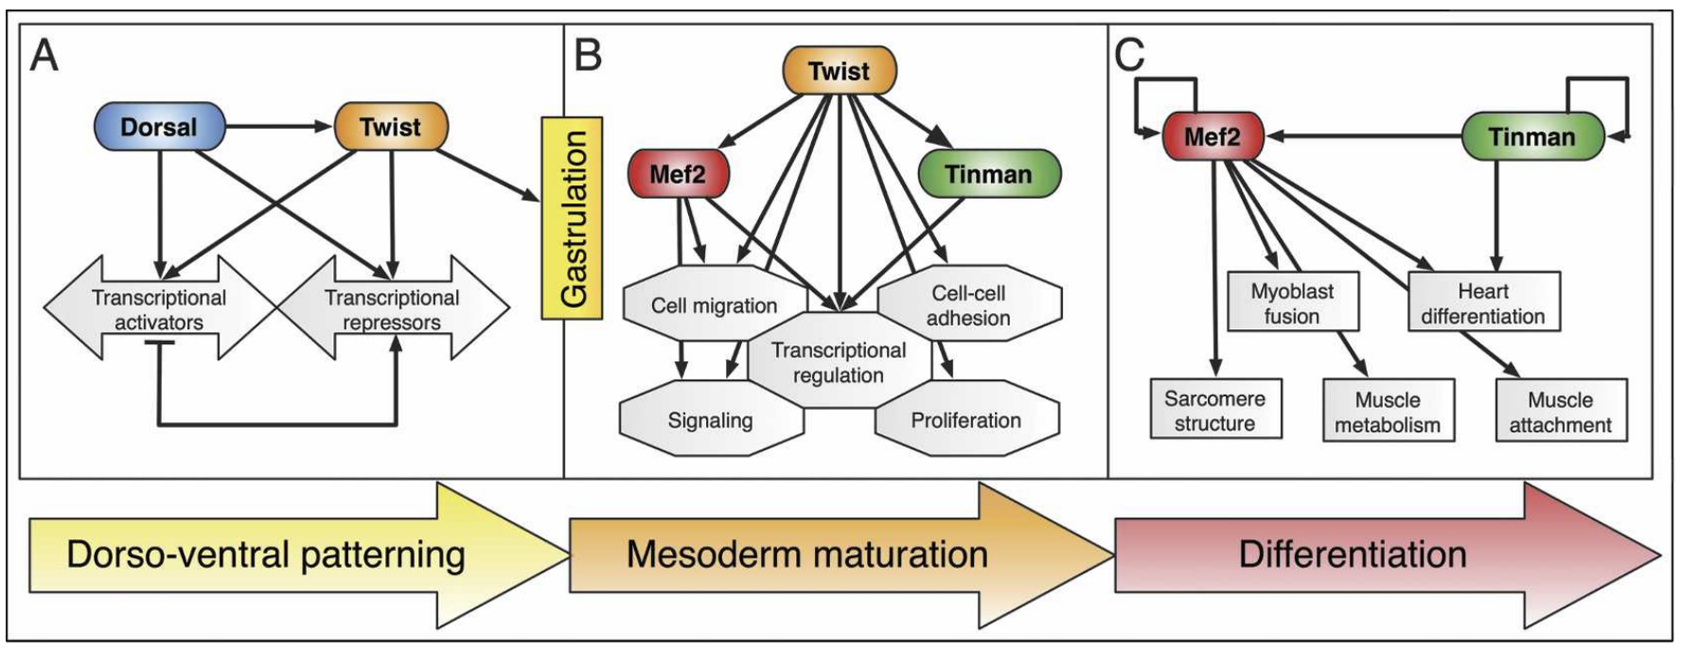
Dm-twist induces mesoderm formation in Drosophila melongaster
directly targeting genes
developmental network ‘plugin’
no twist expression
Twist targets the majority of mesodermal cis-regulatory modules (CRMs)
Twist may provide the competence for more specific TFs to bind to these CRMs; e.g. acting as a pioneer TF to facilitate chromatin remodelling
Twist provides the mesoderm with the competence to be pluripotent
Figure adapted from Thomas Sandmann, et al. 2007, Genes & Development

Slide 4
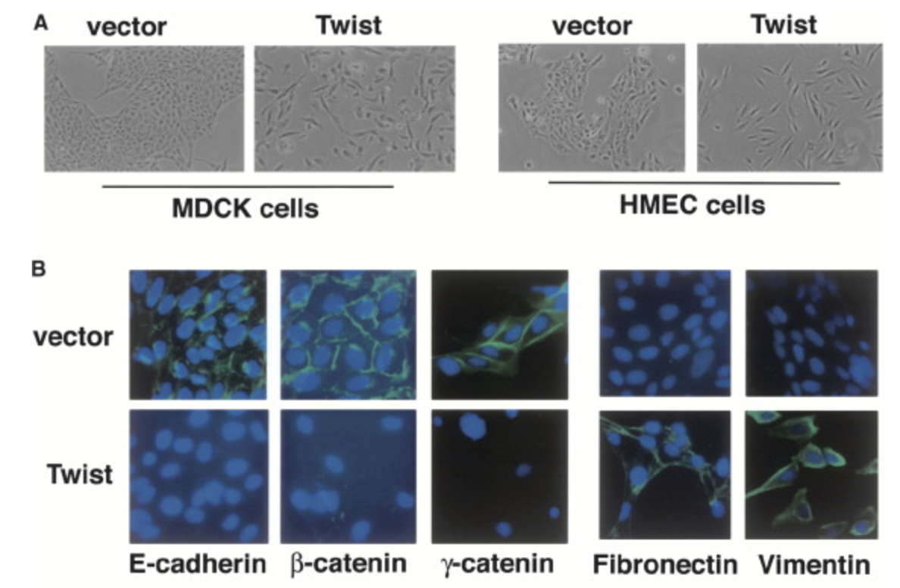
Twist induces metastatic potential of tumor cells via EMT in humans
kidney epithelial cells
loss of cell-cell adhesion and polarity
gain migratory and invasive properties
the expression of fibroblast expression is positively correlated with EMT
suppression of twist reduces metastatic potential in mammary carcinoma cells
Expression of Twist results in loss of E-cadherin-mediated cell-cell adhesion
adherens junction proteins
(markers)
fibroblast markers
Figure adapted from Yang, Y. et al, 2004, Cell

Slide 5
Since cnideria don’t develop a mesoderm, and furthermore no cancer-like phenotype is described to date, we want to decipher the exact role of twist in N.vectensis

Slide 6
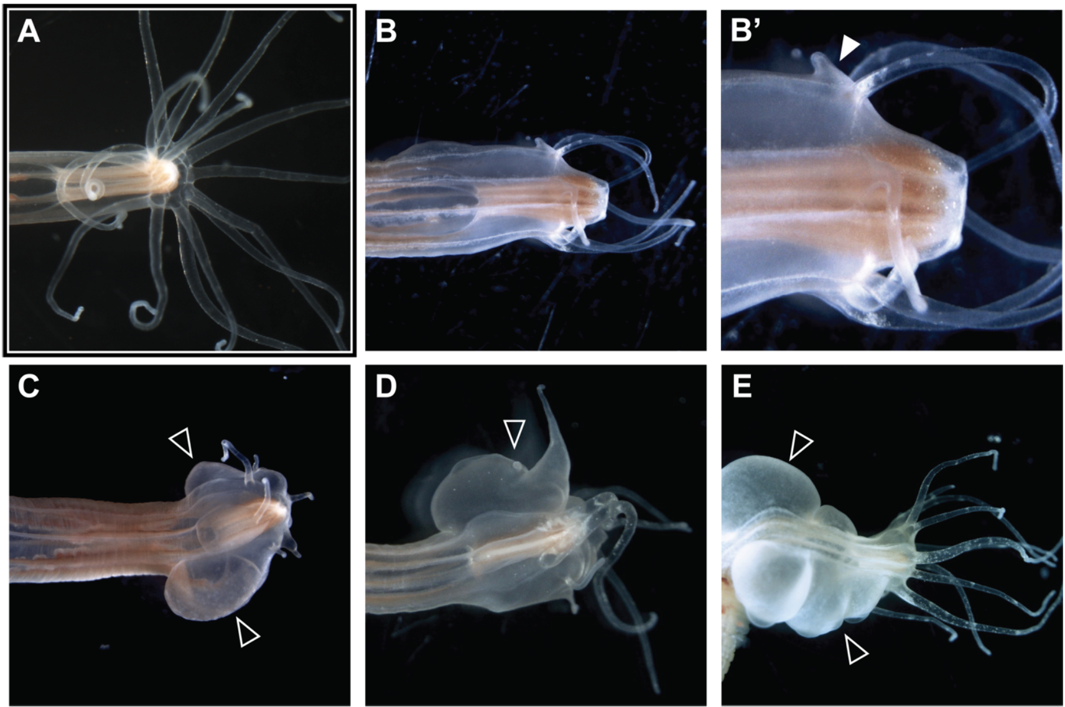
Twist KO causes an novel phenotype in N.vectensis
wild-type
malformed tentacle
CRISPR/Cas9 knockout (GGTAACGT → GGT-----)
defects in tentacle patterning
Nvtwist knockout mutants are
viable
grow to sexual maturity
produce offspring
no abnormalities during gastrulation
‘bubble’ formation
Figure, courtesey of Julia Hagauer

Slide 7
3 hypothesis derived from preliminary results

Slide 8
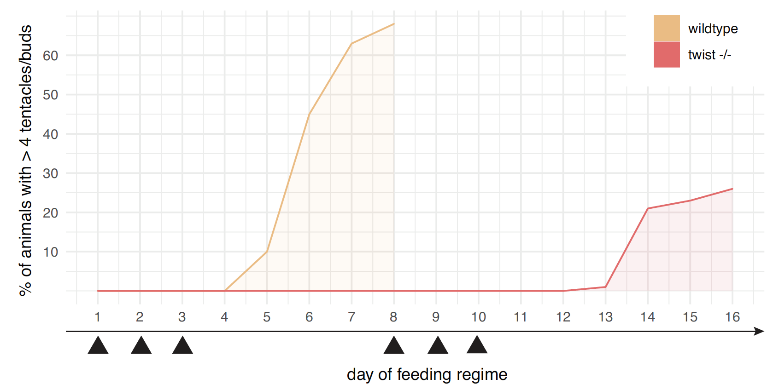
Nvtwist may be involved in tentacle formation via Fgfrb signalling
body size and tentacle development is likely indirectly connected through the animals’ nutritional status
Translated through TOR pathway activity (upregulating Fgfrb)
Twist and Fgfr signalling interactions have been described in various bilaterian species
secondary tentacles formation
Figure, courtesey of Julia Hagauer

Slide 9
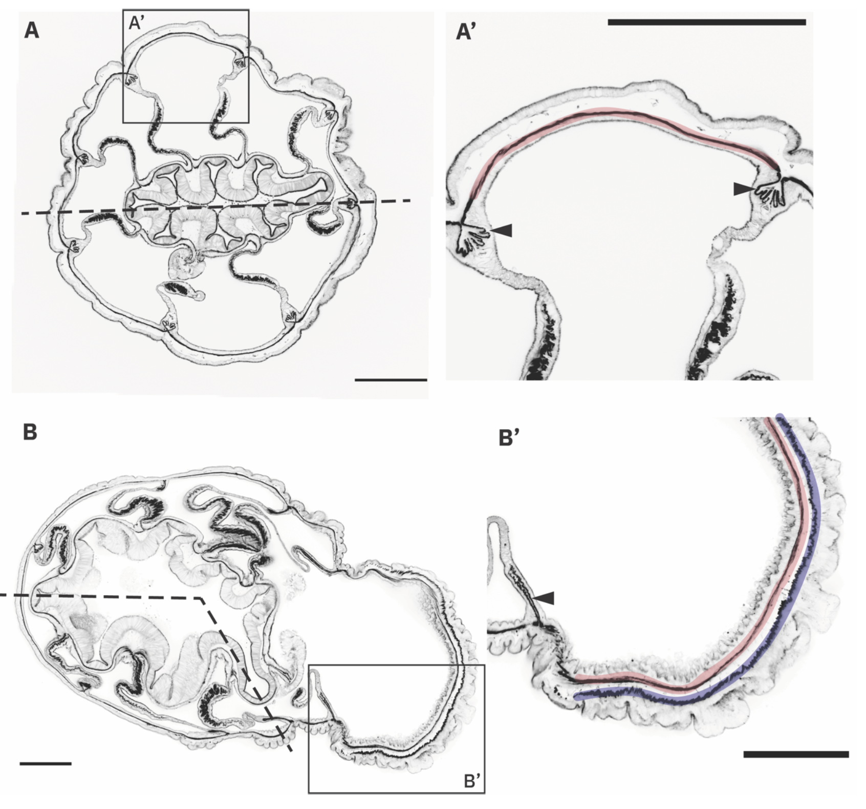
‘Bubble’ might be failed attempt at growing a tentacle
widened space between
circular ring and longitudinal muscle
malformed muscle
Figure, courtesey of Julia Hagauer

Slide 10
’Bubble’ displays a cancer-like phenotype
If bubbles form not due to local proliferation, the additional cells present in bubble tissue may have migrated there, perhaps due to a failure to migrate to their actual destination […]

Slide 11
How do we tackle these hypotheses
We have bulk, and scRNA data of CRISPR/Cas9 twist-mutant and wt animals
Data analysis (2 persons; 6 months)
decipher a potential crosstalk between Target of Rapamycin (TOR) and Fibroblast growth factor receptor (Fgfrb) signalling in ring muscles
decipher if ‘bubble’ has tentacle identity through comparative transcriptomic analysis
decipher if twist interacts with cell-proliferation pathways (RTK/RAS/MAPK) which may portend to a novel cancer-like phenotype
Generation of twist antibody (1 person; 12 months)
Twist-AB can be utilized in a Chip-Seq experiment
Find binding affinities of twist within the genome (direct measure)

Slide 12
Why should we get the funding?
We already have a plethora of data
We have a clear road-map
cancer-like phenotype would display an ultimate novelty
contribution to a broader scientific community
potentially publishing in a high ranking journal (increase the reputation of the lab)
We have a renowned lab with a lot of expertise

Slide 14
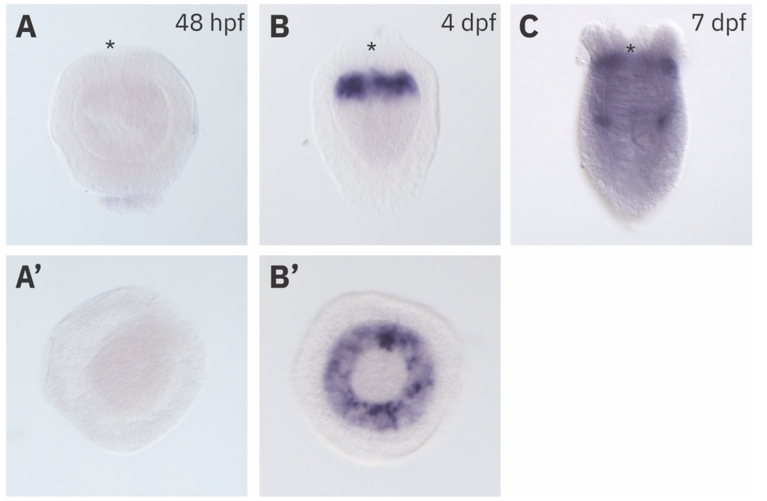
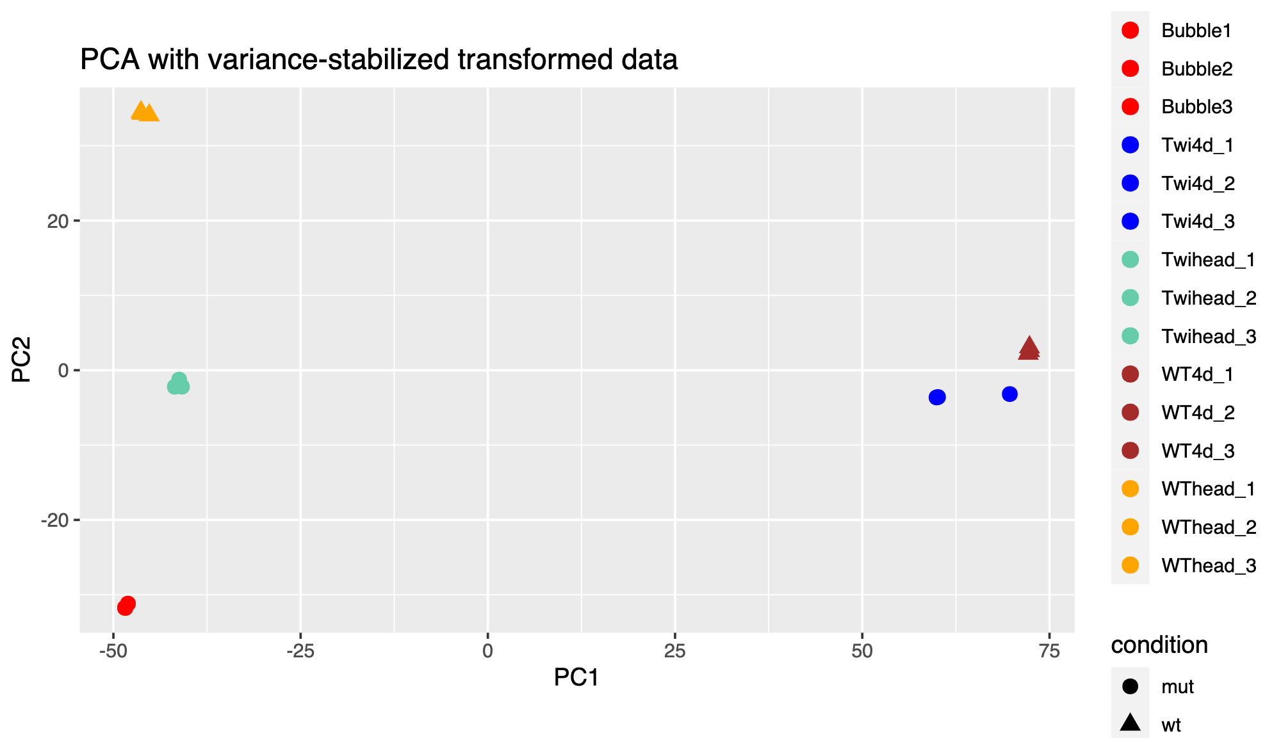
Twist expression correlates with developmental stage
early planula stage
mid-planula stage
primary polyp

Slide 15
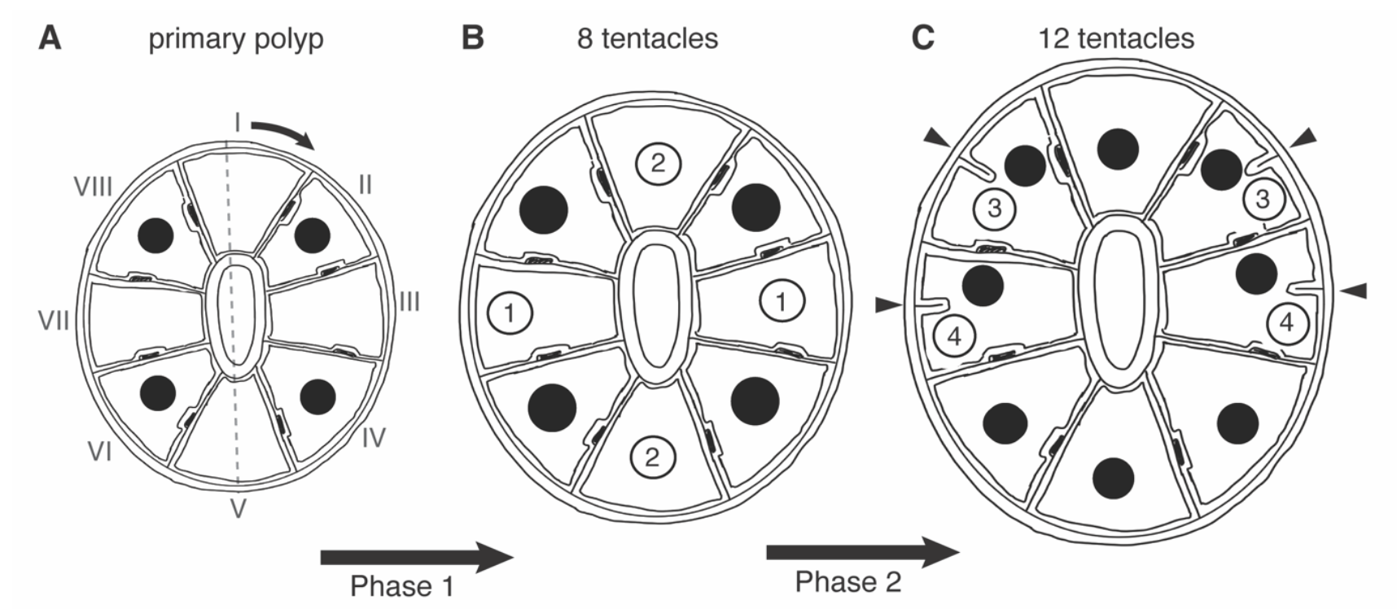
Tentacle formation in N.vectensis
Ikmi, et al. 2020, Nature Communication

Slide 16
One interesting CRISPR/Cas9 off-target
On chromosome 2; Position 3292703 we observed a INDEL
(CTTCCATTT → CTTT------); NV2.10979

Slide 17
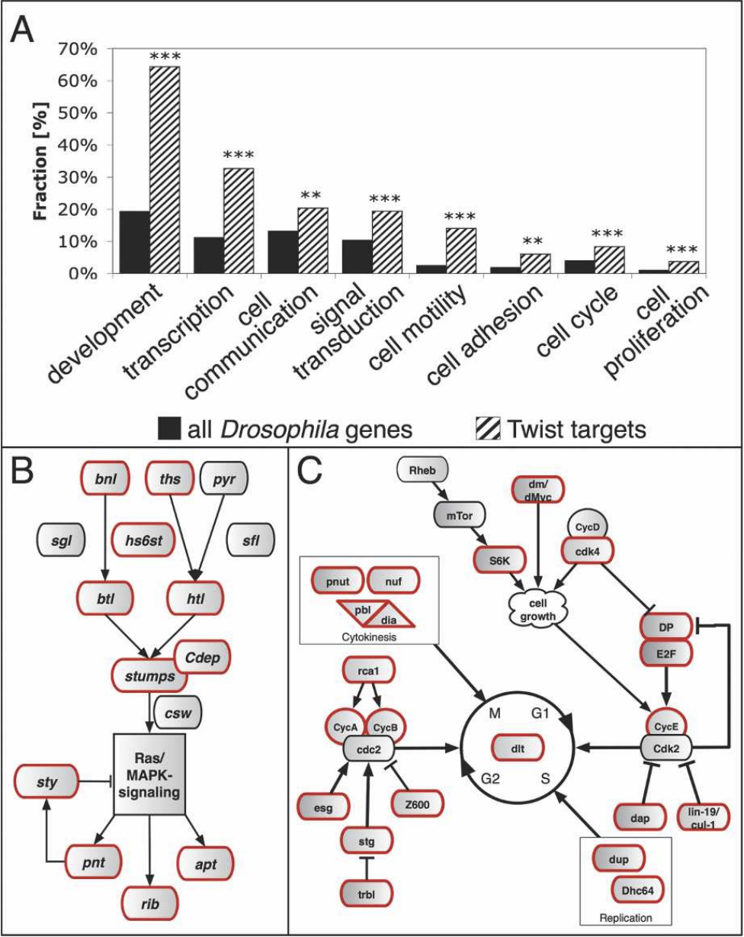
Appendix

